Slide 1


Synopsis Presentation on Comprehensive Digital Learning System for Students
Guided By: Presented By:
Prof. Mahendra Verma Atharv Sharma
Abhishek Rathore
Jatin Rao
Harsh Suryavanshi
Ineesh Dubey

Slide 2
Contents
Introduction
1.1 Overview
1.2 Purpose
Literature Review
Problem Statement
Proposed Solution
Objectives
Theoretical Analysis
6.1 Block Diagram
6.2 Hardware Requirements
6.3 Software Requirements
Applications
8. References

Slide 3
1. Introduction
1.1 Overview
In today’s fast-paced educational environment, access to quality study materials plays a crucial role in student success. Our project aims to develop a comprehensive online platform for students to access, share, and manage study notes effectively.
This website will not only allow users to upload their own notes but also facilitate the sharing of valuable resources among peers. By leveraging technology, we aim to enhance the learning experience, making it more efficient and accessible.
The platform will feature a user-friendly interface that enables seamless navigation through various subjects and topics. Students will have the ability to search for notes based on keywords, making it easier to find relevant materials quickly.
1.2 Purpose
Improved Accessibility: Providing students with easy access to study notes anytime and anywhere, enabling flexible learning that fits their schedules.
Quality Content: Curating high-quality, accurate, and up-to-date study materials to ensure that students have reliable resources for their studies
Personalization: Offering features such as user accounts and saved notes, allowing students to tailor their learning experience according to their individual needs and preferences.

Slide 4
2. Literature Review
Summary of Solutions/Systems already available that are addressing the same issue/problem.
Sr. No. | Name of Solution/System | Features | Limitations/ Drawbacks
1. | Coursera | Offers a wide range of courses from top universities and assessments. | Paid access premium content, limited features for note sharing.
2. | edX | Provides a variety of subjects with certified courses. | Minimal customization options for users.
3. | Evernote | Allows users to create, organize, and share notes across devices. | Lack of collaboration and ratings on shared materials.

Slide 5
3. Problem Statement
Many students find it challenging to locate reliable and comprehensive study materials to their specific curricula. Existing resources are often scattered across various platforms, making it time-consuming and frustrating for students to gather notes.
Current solutions do not promote collaboration among students. This leads to separate learning experiences where students miss out on valuable understanding and diverse perspectives that peer interactions can offer.
Students often struggle to find well-organized notes and study materials, relying on various platforms or personal networks, which can be inconsistent.
Students often lack a centralized platform to organize their notes, leading to disorganization and inefficient study practices.

Slide 6
4. Proposed Solution
The proposed solution is to develop a user-friendly website specifically tailored to students needs, providing them with well-organized notes for different subjects.
The site will be curated with high-quality educational material, ensuring that students have access to reliable content.
The platform will prioritize user-friendliness, accessibility, and effective navigation to enhance the learning experience.
To ensure the reliability of the notes, we will implement a peer-review system. Users can rate and review submitted notes, and the most highly rated resources will be prioritized in search results.
Students will be encouraged to upload their own notes, creating a community-driven platform. Features such as commenting, ratings, and discussions will facilitate collaboration, allowing users to engage with one another and enhance their understanding of the material.

Slide 7
5. Objectives
Promote User Engagement:
Objective: Create an interactive platform that encourages student participation and feedback.
Details: Features such as comments, ratings, and discussion forums will be included, allowing users to share insights and suggest improvements.
⁠Improve Study Efficiency:
Objective: Streamline the studying process by providing concise and organized notes.
Details: Notes will be structured to highlight key concepts, summaries, and essential details, reducing the time students spend searching for information.
Enhance Accessibility:
Objective: Provide a platform where students can easily access study notes from any device with internet connectivity.
Details: The website will be designed with responsive layouts, ensuring usability on desktops, tablets, and smartphones.

Slide 8
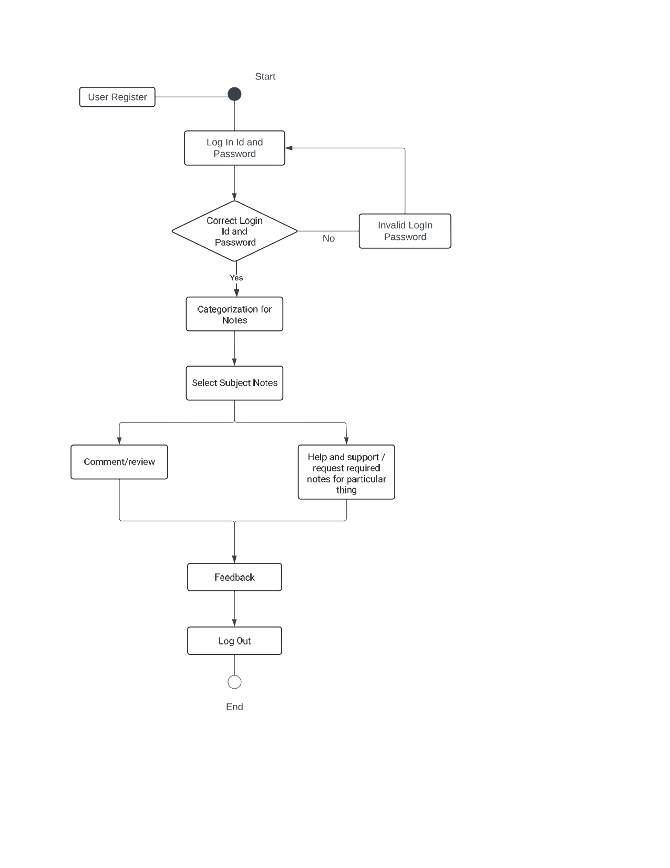
6. Theoretical Analysis
6.1 Block Diagram

Slide 9
6. Theoretical Analysis
6.2 Hardware Requirements:
Computer/Server: A server or cloud hosting to manage website traffic.
Storage Devices: User devices (PC, tablets, smartphones) for students to access the site.
6.3 Software Requirements:
Front-End: HTML 5, CSS 3, JavaScript for designing the website interface
Back-End: Python (Django) 3.13 or PHP for handling requests and managing user interactions.
Database: MySQL or SQLite for storing notes and user data.
Additional Tools: Web hosting services (AWS, or local servers).

Slide 10
Applications
Schools and Colleges: To provide subject-specific notes, helping students prepare for exams.
Online Learning Platforms: The website can be integrated with other online education services to enhance their offerings.
Corporate Training: Employees can use this system for self-paced learning or structured corporate training programs.
Exam Preparation: Provides targeted resources, summaries, and past project references to help students prepare effectively for exams.
Skill Development: Assists in developing research and analytical skills as students engage with diverse resources and contribute their own notes.

Slide 11
GitHub Link
https://github.com/Atharv9406/Minor-Project

Slide 12
REFERENCES
Web development guides and tutorials (MDN, W3Schools).
Textbooks or online resources related to educational platform design.
Existing online note-sharing platforms for reference (e.g., Coursera, edX).
Online Resources and Databases:
1. Google Scholar : Academic papers and theses.
2. JSTOR : A digital library for academic journals, books, and primary sources.
3. IEEE Xplore : For engineering and technology students.
4. PubMed : Medical and biological research.
5. Research papers, journals, and books from faculty.
6. Websites or databases the department recommends (e.g., JSTOR, IEEE, etc.)

Slide 13
Thank You
Queries ?

